Slide 1
Adventure WORKS ANALYSIS

Slide 2
PART 1: Importing DATA

Slide 3
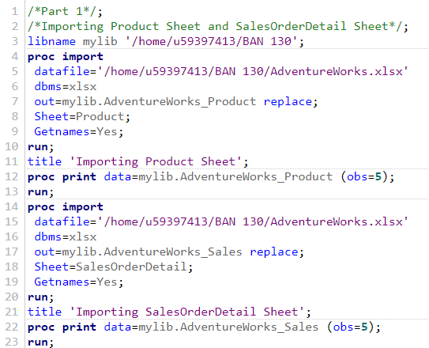
Importing Product and SalesOrderDetail sheets from the AdventureWorks dataset using PROC IMPORT
Note the use of Sheet function to read the dataset from a single Excel file
Output files:
Product
SalesOrderDetail

Slide 4
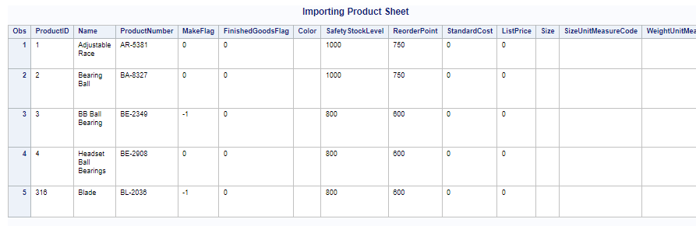
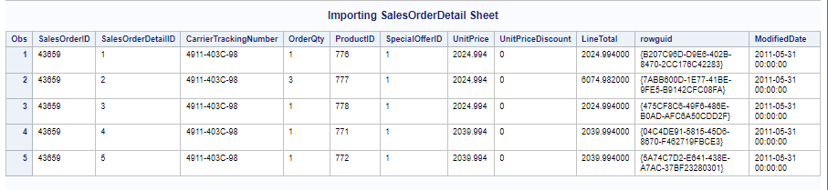
Outputs from PROC IMPORT

Slide 5
PART 2: CLEANING DATA

Slide 6
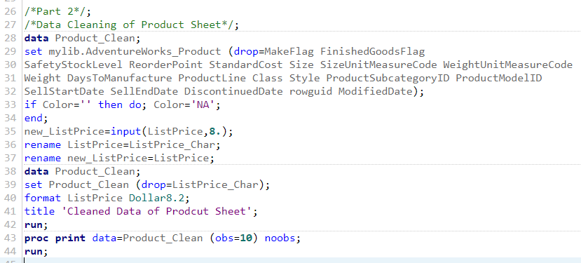
Importing Product and SalesOrderDetail sheets from the AdventureWorks dataset using PROC IMPORT
Replacing the missing values of ‘Color’ with ‘NA’ and converting character variable to numeric
Renaming the variable names using ‘Rename’ function
Formatting the ListPrice to a non standard numeric value

Slide 7
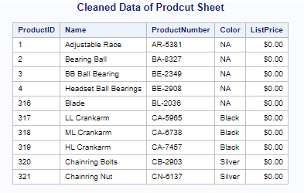
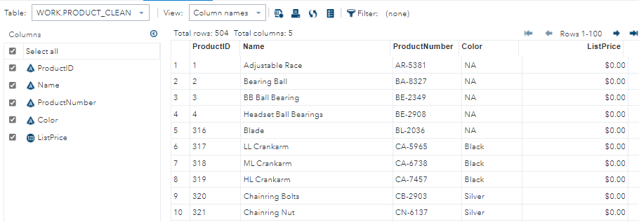
CLEANING OF PRODUCT DATA

Slide 8
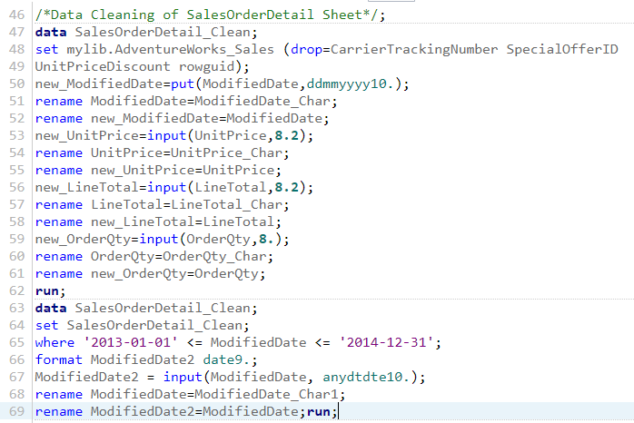
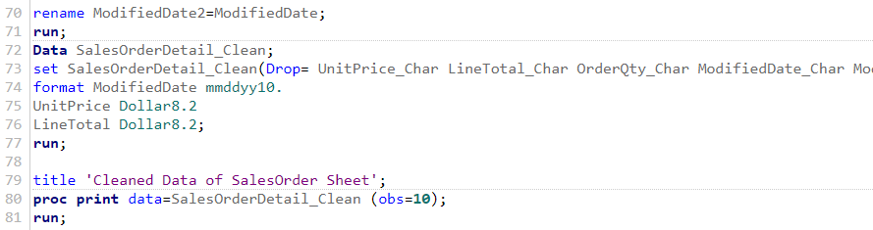
CLEANING OF SALES DATA

Slide 9
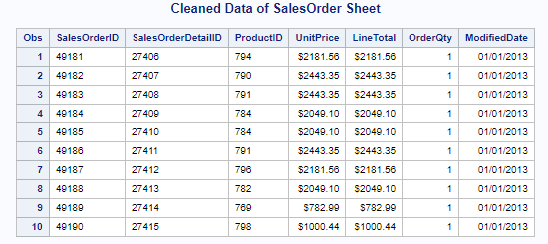
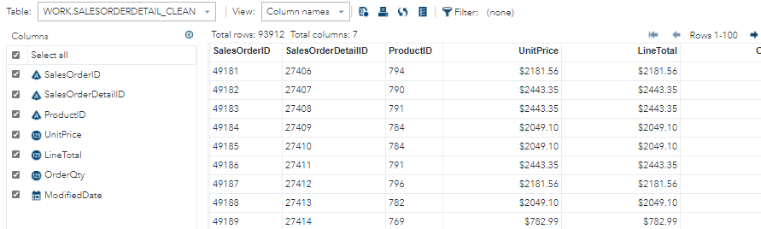
CLEANING OF SALES DATA

Slide 10
PART 3: MERGING DATA

Slide 11
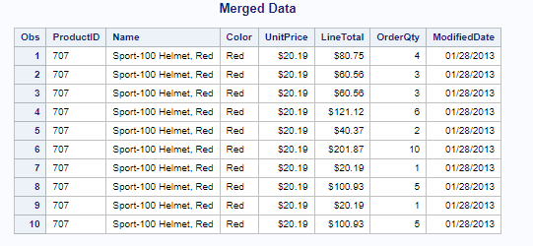
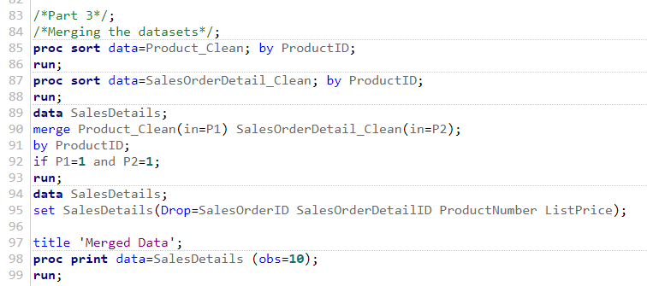
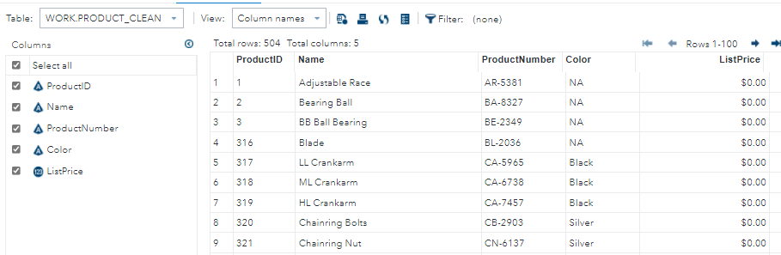
Creating SalesDetails: Joining and Merging Product and SalesOrderDetail datasets using PROC SORT and MERGE

Slide 12
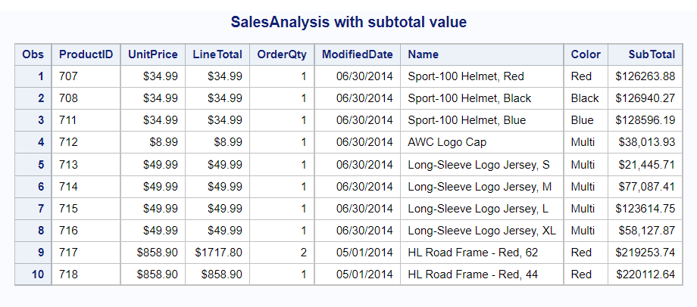
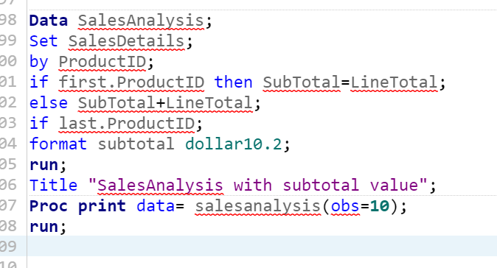
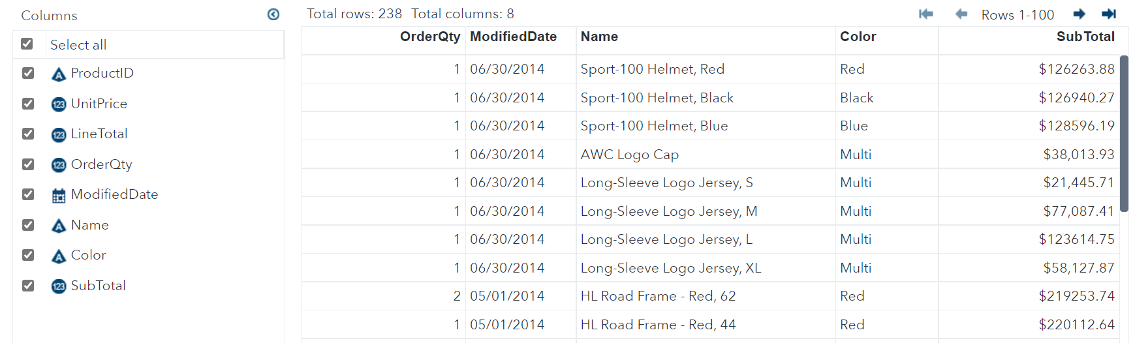
Creating SalesAnalysis: Grouped all products by ProductID in SalesDetails dataset using RETAIN and BY
Creating SalesAnalysis: Grouped all products by ProductID in SalesDetails dataset using RETAIN and BY

Slide 13
PART 4: ANALYZING DATA

Slide 14
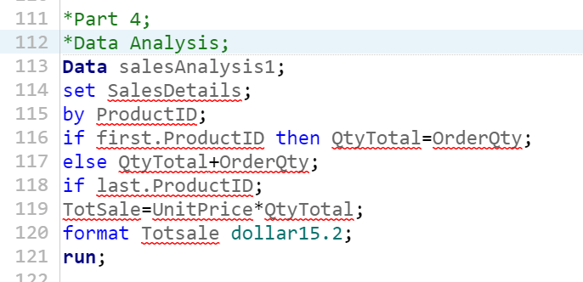
Conducted DataAnalysis to obtain the answer to the 5 questions mentioned in step 4 and created chart using PROC GCHART
Creating SalesAnalysis1 to get the QTYTOTAL variable to get the total quantity of items sold

Slide 15
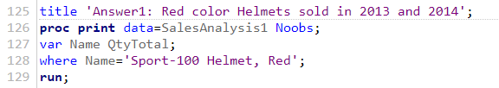

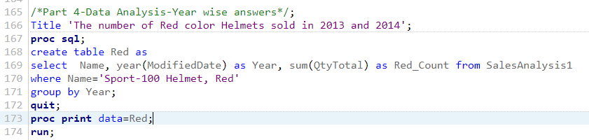

Conducted DataAnalysis to obtain the answer to the 5 questions mentioned in step 4 and created chart using PROC GCHART Answer 1:

Slide 16
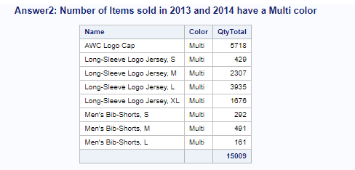
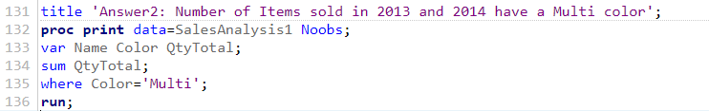
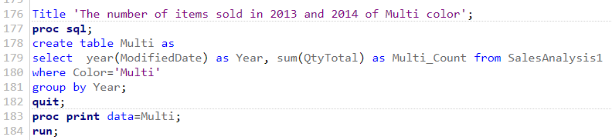

Conducted DataAnalysis to obtain the answer to the 5 questions mentioned in step 4 and created chart using PROC GCHART Answer 2:

Slide 17
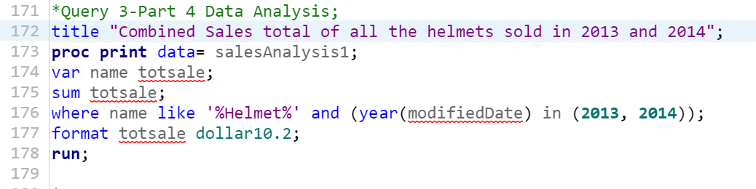
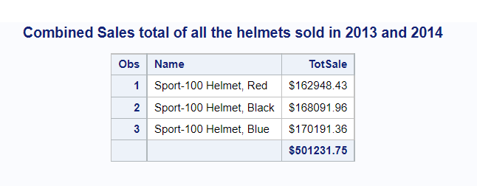
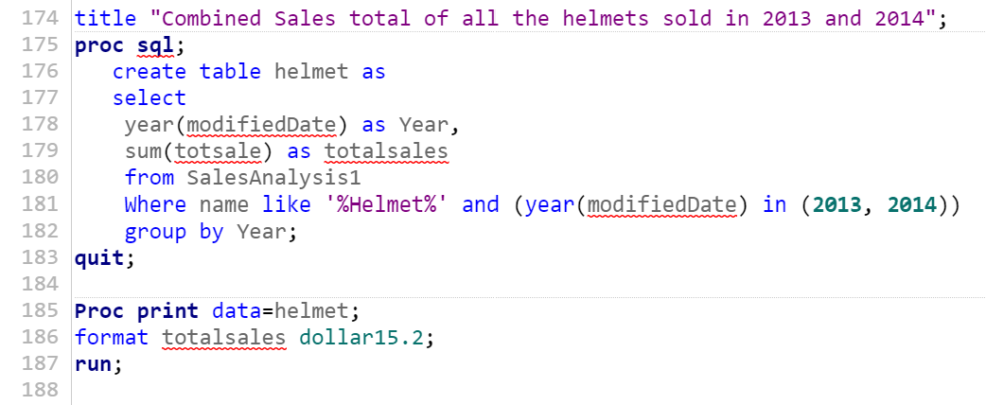
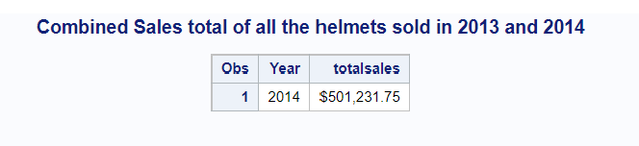
Conducted DataAnalysis to obtain the answer to the 5 questions mentioned in step 4 and created chart using PROC GCHART Answer 3:

Slide 18
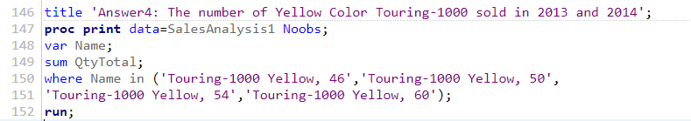
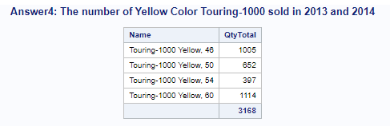
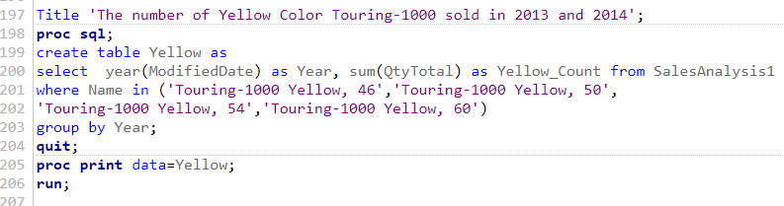

Conducted DataAnalysis to obtain the answer to the 5 questions mentioned in step 4 and created chart using PROC GCHART Answer 4:

Slide 19
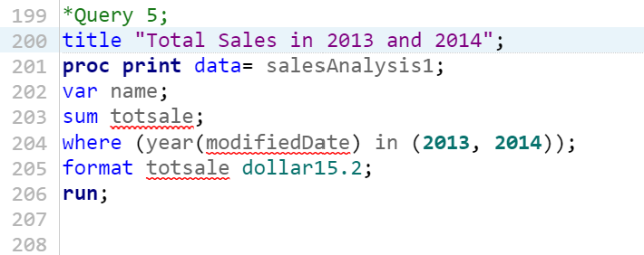
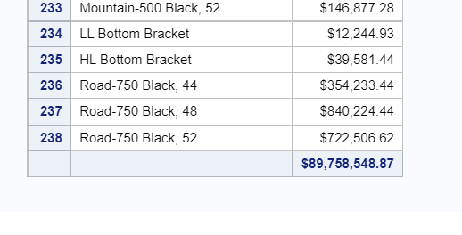
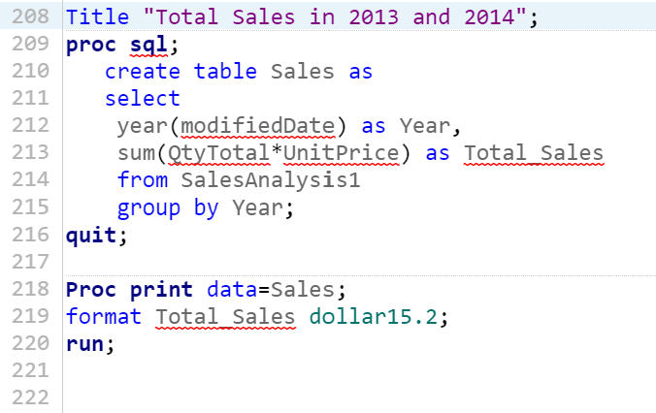
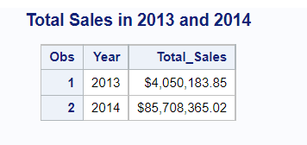
Conducted DataAnalysis to obtain the answer to the 5 questions mentioned in step 4 and created chart using PROC GCHART Answer 5:

Slide 20

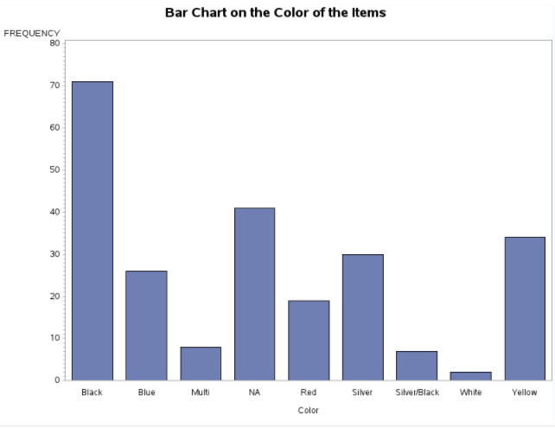
Conducted DataAnalysis to obtain the answer to the 5 questions mentioned in step 4 and created chart using PROC GCHART BAR CHART:

Slide 21
THANK YOU

